Slide 1
Title: Knapsack Algorithm Implementation and Analysis
1
M Daniyal Saffi (BSCS-31)
Muhammad Sajid (BSCS-28)
Course: Analysis of Algorithm
Department of Computer Science
Namal University, Mianwali

Slide 2

CONTENT
2
Introduction
Aim
Algorithm Design
Algorithm Analysis
Algorithm Execution
Code
Conclusion

Slide 3
Aim:
3
Implement and analyze
Implement and analyze the Knapsack Problem algorithm in Python.
Maximize
- Maximize total profit of selected items with a limited knapsack capacity.
Focus on
- Focus on 0/1 Knapsack and Fractional Knapsack algorithms.
Optimize
- Optimize item selection based on weights, profits, and capacity constraint.

Slide 4
ALGORITHM DESIGN:
0/1 Knapsack Algorithm
4
- Sort weights in ascending order and create a profit value list.
- Initialize a table with zero entries for maximum achievable profit.
- Iterate over items and capacities, fill table based on maximum profit.
- Backtrack through the table to determine selected items and total profit.

Slide 5
Algorithm Design:
Fractional Knapsack Algorithm
5
- Calculate profit-to-weight ratio for each item.
- Sort ratios in descending order, create profit and weight value lists.
- Iterate through items, greedily select based on ratios until capacity is reached.

Slide 6

ALGORITHM ANALYSIS
6
- 0/1 Knapsack algorithm:
Time complexity of O(n*W).
- Fractional Knapsack algorithm:
Time complexity of O(n log n).

Slide 7
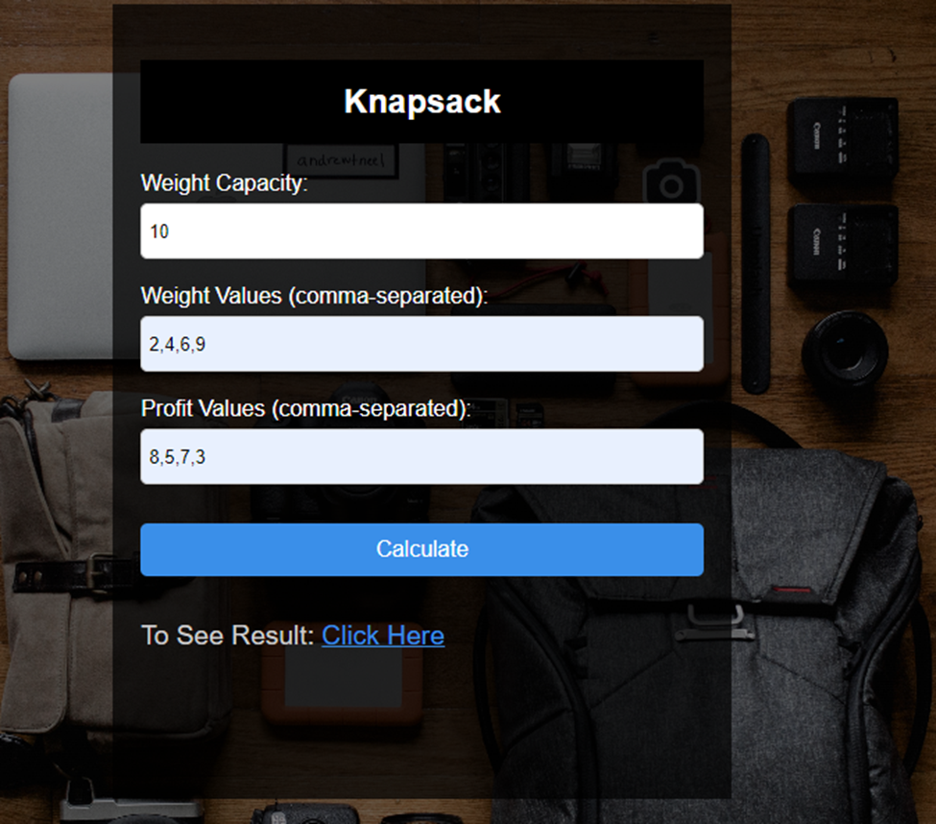
ALGORITHM EXECUTION
7
INPUT

Slide 8
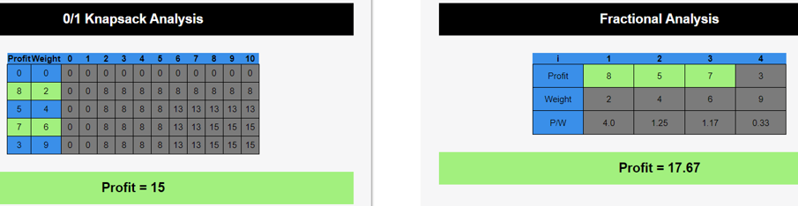
ALGORITHM EXECUTION
8
OUTPUT

Slide 9
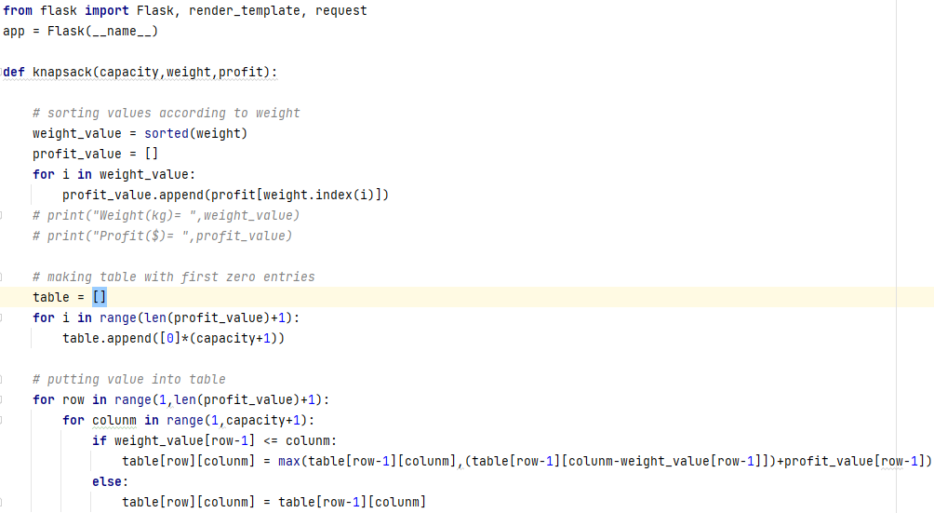
SAMPLE CODE
9

Slide 10
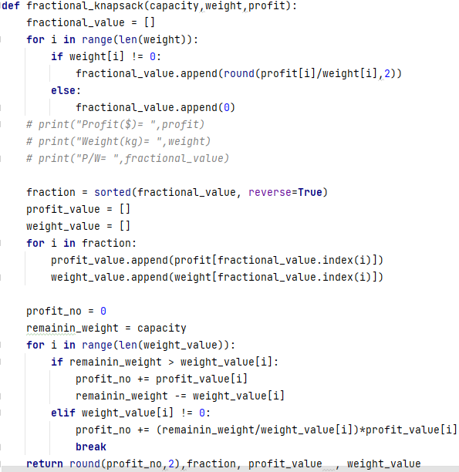
10

Slide 11

11
Successful implementation and analysis of the Knapsack Problem algorithm
Study and implementation of the 0/1 Knapsack and Fractional Knapsack algorithms
Optimal solution provided by the 0/1 Knapsack algorithm with O(nW) time complexity
Greedy approach demonstrated by the Fractional Knapsack algorithm with O(n log n) time complexity
Satisfactory results obtained from the algorithm execution
Contributes to a better understanding of the Knapsack Problem

Slide 12


